Slide 1
All about XSS Attacks
Cross site Scripting Attach : XSS

Slide 2
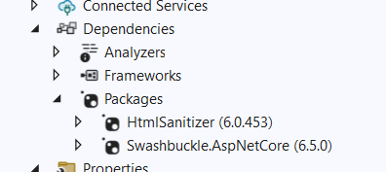
Steps :
1Create WebAPI project in .netcore 6
2Add Nuget Pakages as follows
Add DemoController
Write a HTTPPost method
[Route("PostComtactMessage")]
[HttpPost]
public async Task <IActionResult> PostComtactMessage(ContactForModel model)
{
if (model!=null) {
return Ok("Success");
}
public class ContactForModel
{
public string Name { get; set; }
public string Email { get; set; }
public string Message { get; set; }
}
else
return BadRequest();
}

Slide 3
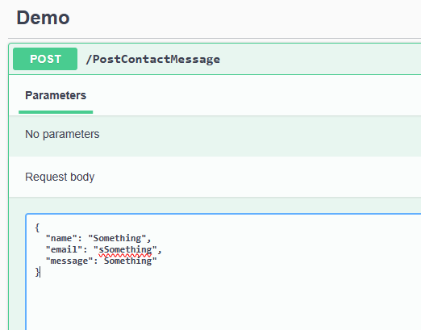
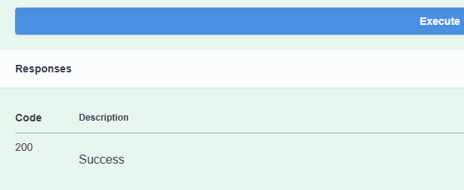
Steps :
4: Run the app in Swagger and use following data
You will get success

Slide 4
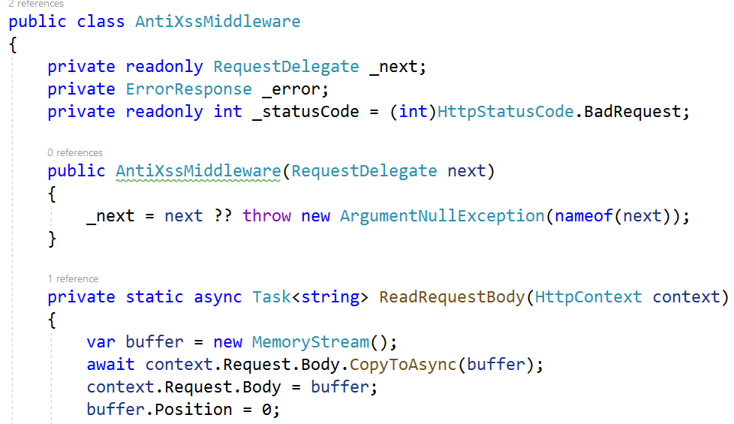
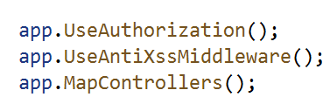
Steps :
5:Add CustomMiddleware class
6 :Configure it in RequestPipeline Middlware
7 Run the app in Swagger and use following data
You will get BadRequest as a response

